Slide 1
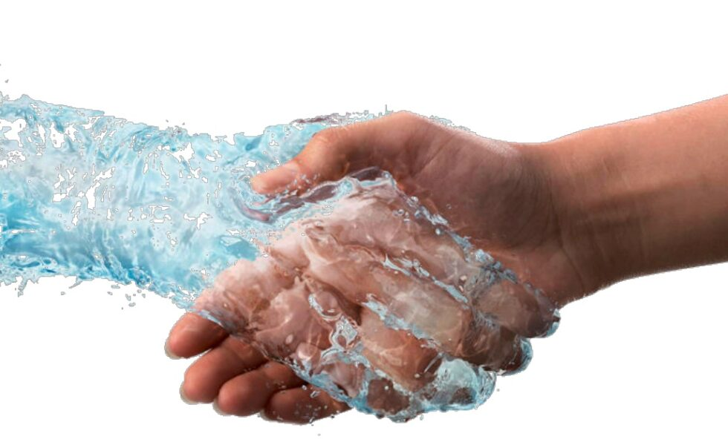
WATER QUALITY PREDICTION
Team Members:
Nishant J
Sashanth A Mogre
Harshal Rajesh
Sriya Ellur
Vaishnavi Thiruvayarpadi
Sai Chandrika

Slide 2
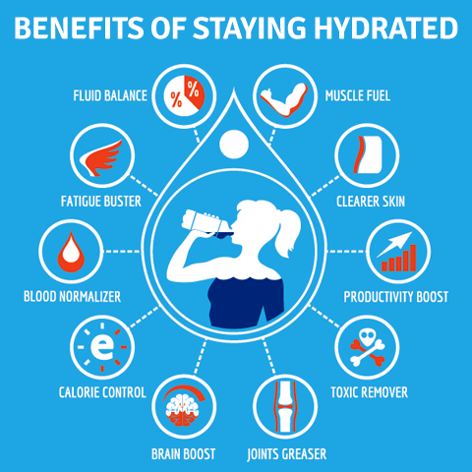
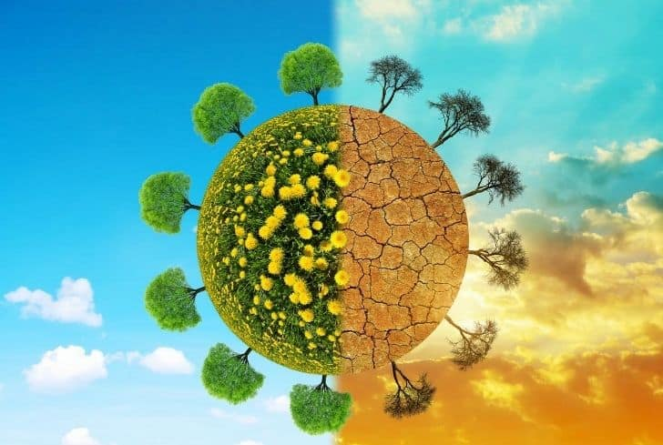

Slide 3
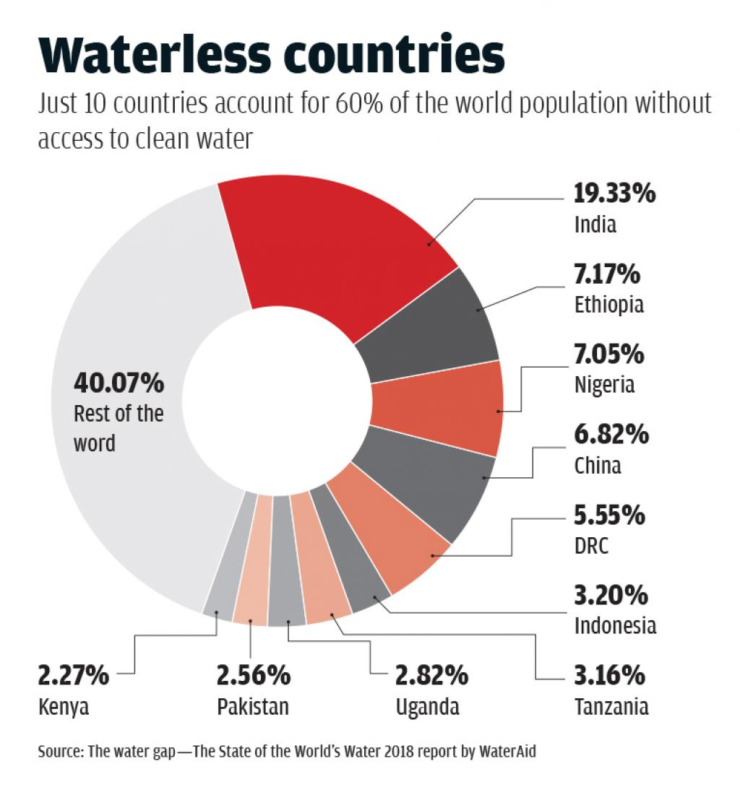
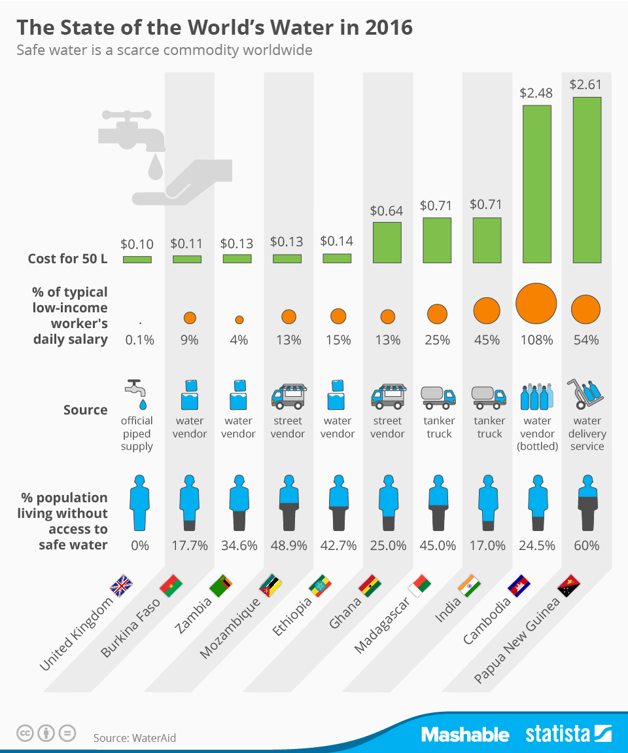

Slide 4
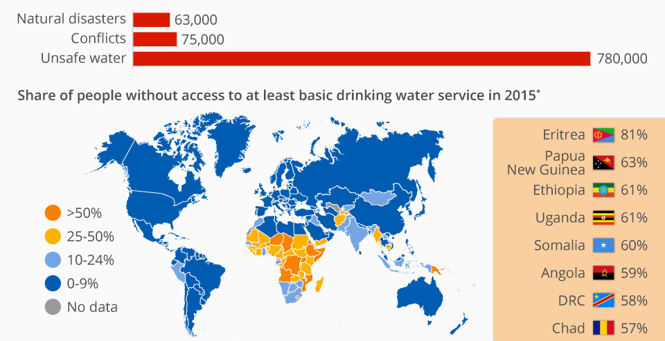

Slide 5
What is in water?
Components | Permit able Range
pH value | pH from 6.5 to 8.5
Hardness | 0 to 60 mg/L calcium carbonate is soft. 61 to 120 mg/L as moderately hard. 121 to 180 mg/L as hard 180 mg/L as very hard.
Solids (Total dissolved solids - TDS) | Desirable - TDS is 500 mg/l maximum -1000 mg/l which prescribed for drinking purpose
Chloramines | up to 4 milligrams per liter
Sulfate | 3 to 30 mg/L
Conductivity | should not exceeded 400 μS/cm
Organic carbon | < 2 mg/L
Trihalomethanes | 80 ppm is considered safe
Turbidity | 5.00 NTU

Slide 6
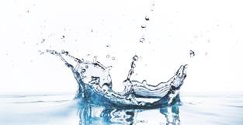
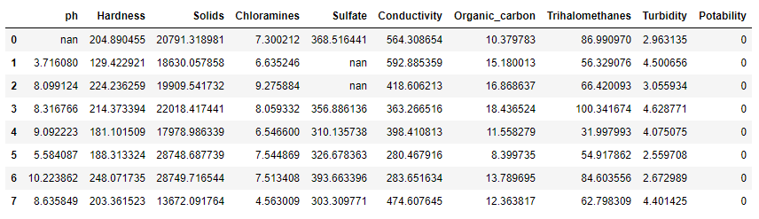
DATA SET

Slide 7

STEPS FOLLOWED
Data Cleaning
EDA
Finding significant features
Logistic Regression
KNN
Decision Tree
Random Forest
Adaboosting
Gradient Boosting
Extreame Gradient Boosting

Slide 8
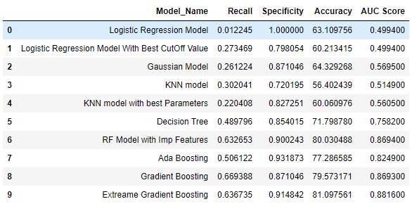
BEST MODEL

Slide 9

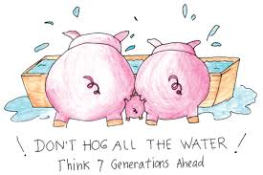
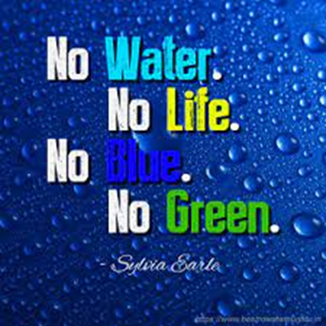
Thank You!

